Slide 1

School of Computing Science and Engineering
Course Code: BCS01T1003 Course Name: Programming for Problem Solving C
UNIT 2
CONSTRUCTS OF C
Data types and storage classes
Program Name: B.Tech (CSE)

Slide 2
Recapitulations
Process of writing a C program
C Character Set
C Tokens
Keywords
Identifiers/Variables
Constants
Datatypes in C

Slide 3
Objectives
Datatypes revisited
long
short
signed
unsigned
Storage classes
auto
register
extern
static

Slide 4
Datatypes Revisited
Integers, long and short
C offers a variation to integer data by using keywords – long and short.
Based on the 16-bit or 32-bit compiler, the size of each varies as below:
Some generic rules:
short is at least 2 bytes big.
long is atleast 4 bytes big.
short is never bigger than int.
int is never bigger than long.
Declarations:
long int i;
long abc;
short int j;
short xyz;
Compiler | short | int | long
16-bit (Turbo C/C++) | 2 | 2 | 4
32-bit (Visual C++) | 2 | 4 | 4

Slide 5
Datatypes Revisited
Integers, signed and unsigned
When value stored by integer is always positive, we can use keyword unsigned as:
unsigned int num_students;
unsigned i;
With above declaration, the permissible range of integer values for 16-bit compiler will shift from -32768 to +32767 to range 0 to 65535.
Chars, signed and unsigned
unsigned and signed char, both occupy 1 byte each.
signed char has a range from -128 to 127 whereas unsigned char has range from 0 to 255.

Slide 6
Datatypes Revisited
Float, Double and long
float occupies 4 bytes in memory ranging from -3.4e38 to +3.4e38.
double occupies 8 bytes in memory ranging from -1.7e308 to +1.7e308.
If situation demands even a bigger range then long double can be used to obtain range of -1.7e4932 to +1.7e4932.
long double occupies 10 bytes in memory.

Slide 7
Storage Classes
A variable’s storage class tells us:
where the variable would be stored.
what will be the initial value or default value.
what is the scope of the variable i.e. in which functions the value of the variable would be available.
what is the life of variable i.e. how long would the variable exist.
There are four storage classes in C:
Automatic storage class
Register storage class
Static storage class
External storage class

Slide 8
Automatic Storage Class
This is the default storage class.
The details are as follows:
Storage - Memory
Default initial value - Garbage value (unpredictible)
Scope - Local to the block in which variable is defined
Life - Till control remains within the block in which variable is defined.
Keyword - auto
Declaration is done as:
auto int i,j;

Slide 9
Register Storage Class
This stores the data in CPU registers.
Since registers are limited, if a CPU register is unavailable, the data is stored as auto despite being declared with register storage class.
The details are as follows:
Storage - CPU registers
Default initial value - Garbage value (unpredictible)
Scope - Local to the block in which variable is defined
Life - Till control remains within the block in which variable is defined.
Keyword - register
Declaration is done as:
register int i,j;

Slide 10
Static Storage Class
This hold the value in between function calls.
Useful as counters.
The details are as follows:
Storage - Memory
Default initial value - Zero
Scope - Local to the block in which variable is defined
Life - Value of the variable persists between different function calls.
Keyword - static
Declaration is done as:
static int i,j;

Slide 11
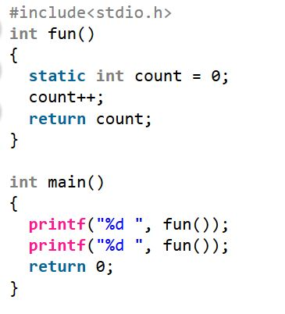
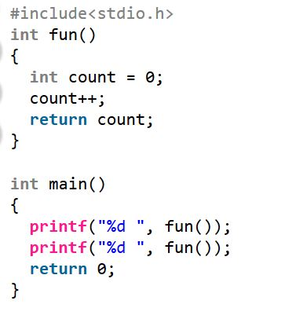
Static Storage Class
Static Example Non-static example
OUTPUT: 1 2 OUTPUT: 1 1

Slide 12
External Storage Class
They are declared outside all functions.
They are available to all the functions that wish to use them..
The details are as follows:
Storage - Memory
Default initial value - Zero
Scope - Global
Life - As long as the program’s execution doesn’t come to an end.
Keyword - extern
Declaration is done as:
extern int i;

